Slide 1
Understanding Native Applications, Tools, Mobility, and Remote Management and Assistance
Lesson 3

Slide 2
Objectives
Skill/Concept | Exam Objective | Objective Number
Configuring Internet Explorer | Configure native applications and tools Configure applications | 1.3 3.1
Configuring Microsoft Edge | Configure native applications and tools | 1.3
Configuring Cortana | Configure native applications and tools | 1.3
Introducing Accessory Programs | Configure native applications and tools | 1.3
Supporting Mobile Access and Data Synchronization | Configure mobility settings Understand offline files | 1.4 4.4
Using Windows Mobility Center | Configure mobility settings | 1.4
Accessing a Computer Remotely | Configure native applications and tools Configure and use management tools | 1.3 1.5

Slide 3
Configuring Internet Explorer
Internet Explorer is the traditional Microsoft browser that offers a number of features to protect your security and privacy while you browse the web, including phishing filters, Protected Mode, Pop-up Blocker, Add-on Manager, download files or software notification, and the use of digital signatures and 128-bit secure (SSL) connections when using secure websites.

Slide 4
Configuring Security Zones
To help manage Internet Explorer security when visiting websites, Internet Explorer divides your network connection into security zones based on four content types. For each zone, a security level is assigned.

Slide 5
Using Dynamic Security and Protected Mode
Internet Explorer offers multiple security features to defend against malware and data theft, including dynamic security and protected mode.
Dynamic security is a set of tools and technology that protects your computer as you browse the internet with Internet Explorer. It includes ActiveX opt-in, Security Status Bar, Phishing Filter, Address Bar Protection, and protected mode.

Slide 6
Configuring the SmartScreen Filter and Phishing
Phishing is a fraudulent technique based on social engineering.
With phishing, users are enticed (usually through email or other websites) to go to illegitimate websites that look similar to legitimate websites in an effort to persuade users to supply personal information, such as passwords and account numbers.

Slide 7
Managing Add-Ons (1/2)
To make Internet Explorer more flexible, Internet Explorer allows you to add add-ons to your browser, such as extra toolbars, animated mouse pointers, stock tickers, and pop-up blockers.
Add-ons are downloaded from the internet and installed as an executable program.

Slide 8
Managing Add-Ons (2/2)
As newer technology is implemented on websites, sometimes websites don’t look like you expect them to.
Images might not appear, menus might be out of place, and text could be jumbled together.
In these situations, you can try to run the site in compatibility mode.

Slide 9
Configuring SSL and Certificates (1/2)
Secure Sockets Layer (SSL) uses a cryptographic system that uses two keys—one key to encrypt the data and another key to decrypt the data.
The public key is known to everyone and a private or secret key is known only to the recipient of the message. The public key is published in a digital certificate, which also confirms the identity of the web server.

Slide 10
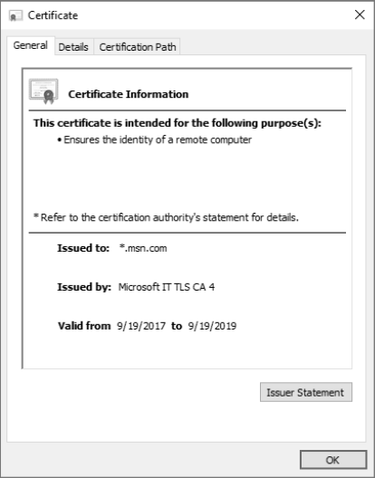
Configuring SSL and Certificates (2/2)

Slide 11
Managing Favorites
Favorites allow you to keep track of websites that you visit frequently so that you can visit them quickly in the future.
If you’re on a site that you want to make a favorite, click the Favorites (star) button and click Add to favorites. You can also save a favorite by pressing Ctrl+D. You will then be prompted to name the favorite and identify which folder the favorite will be stored in.

Slide 12
Managing LAN Settings
Although Classless Inter-Domain Routing (CIDR) helped use the IPv4 addresses more efficiently, additional steps were necessary to prevent the exhaustion of IPv4 addresses.
Network Address Translation (NAT) is used with masquerading to hide an entire address space behind a single IP address. In other words, it allows multiple computers on a network to connect to the internet through a single IP address.

Slide 13
Configuring Microsoft Edge
Microsoft Edge is a new Microsoft lightweight web browser with a layout engine built around web standards designed to replace Internet Explorer as the default web browser.
It integrates with Cortana, annotation tools, Adobe Flash Player, a PDF reader, and a reading mode. Extension support was developed and added to the Windows 10 Anniversary Update in July 2016.

Slide 14
Configuring Cortana (1/2)
Cortana is a search feature and personal assistant for Windows 10.
It can help you find programs and files on your computer and manage your calendar events.
It can also deliver sports scores, weather, news, navigation, reminders, and more. When you search, you can either type what you are looking for, or if you have a microphone, you can speak to Cortana.

Slide 15
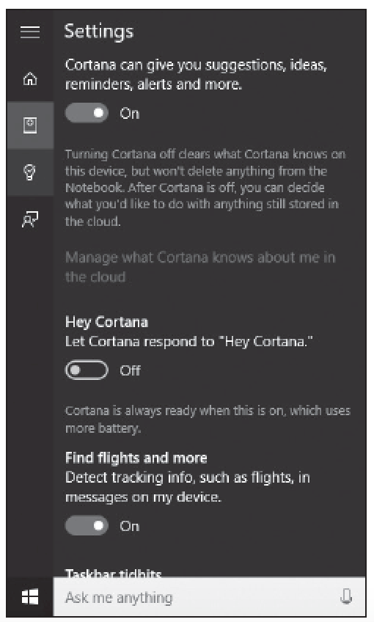
Configuring Cortana (2/2)

Slide 16
Using the Snipping Tool
A screenshot, also referred to as a snip or screen grab, is a snapshot of whatever is displayed on the computer screen.
Snipping Tool is an accessory program that comes with Windows 10 that allows you to take screen shots, annotate them, and save them.

Slide 17
Using Windows Media Player
Windows Media Player 12 is a program that allows you to play back music and video files and view photos.
Files stored in your Music, Pictures, and Videos libraries appear in the Windows Media Player file list by default.
On a network, you can stream digital media files—audio, video, or photos—for playback or viewing from another computer or a server that hosts Windows media files.

Slide 18
Using Windows Mobility Center (1/2)
Windows Mobility Center is a control panel of sorts that gives you access to several laptop settings, from volume to screen brightness to power options to Wi-Fi and Bluetooth settings—all in one place.
Although the settings can be accessed from various icons and commands within Windows, you can make adjustments from a single window in Windows Mobility Center.

Slide 19
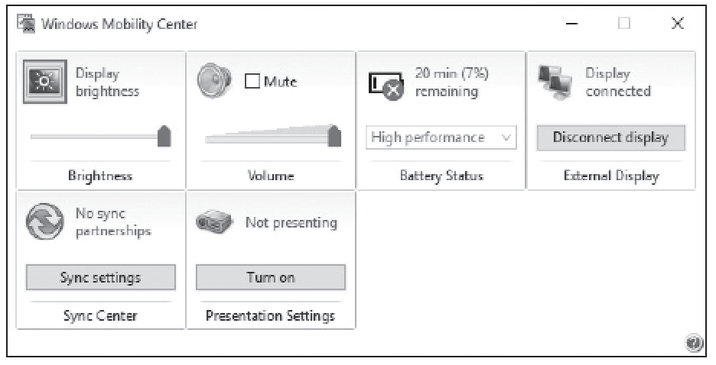
Using Windows Mobility Center (2/2)

Slide 20
Configuring Remote Desktop (1/2)
RDP connects to another computer over a network connection using the same graphical interface that you
would use if you were sitting in front of the physical server.
Typically, you would access computers remotely using the Remote Desktop Connection (RDC), which allows you to connect to a Remote Desktop Session Host or to a Remote Application.

Slide 21
Configuring Remote Desktop (2/2)
Remote Assistance is a Windows 10 feature that enables an administrator, trainer, or support person to connect to a remote user’s computer, chat with the user, and either view all of the user’s activities or take complete control of the system.
Similar to Remote Desktop, it also uses TCP port 3389.

Slide 22
Using Windows Remote Management
Windows Remote Management (WinRM) is a Windows 10 service that enables administrators to execute commands on remote computers using Windows PowerShell or the Windows Remote Shell (WinRS.exe) command-line program.
However, Windows 10 does not start the service by default or configure the computer to allow remote management communications.

Slide 23
Using WinRS.exe
After you have configured the Remote Management service, you can execute commands on other computers that have been similarly configured.
To execute a command from the Windows 10 command prompt, you must use the WinRS.exe program.

Slide 24
Introducing Windows PowerShell
Windows PowerShell is a command-line interface used mainly by IT professionals to run cmdlets (pronounced command-lets), complete background jobs (processes or programs that run in the background without a user interface), and run scripts to perform administrative tasks.

Slide 25
Summary (1/5)
Internet Explorer is the traditional Microsoft browser that offers a number of features to protect your security and privacy while you browse the web, including phishing filters, Protected Mode, Pop-up Blocker, Add-on Manager, download files or software notification, and the use of digital signatures and 128-bit secure (SSL) connections when using secure websites.

Slide 26
Summary (2/5)
Microsoft Edge is the new Microsoft lightweight web browser with a layout engine built around web standards designed to replace Internet Explorer as the default web browser.
It integrates with Cortana, annotation tools, Adobe Flash Player, a PDF reader, and a reading mode.

Slide 27
Summary (3/5)
Windows Media Player 12 is a program that allows you to play back music and video files and view photos. Files stored in your Music, Pictures, and Videos libraries appear in the Windows Media Player file list by default.
Users who work across multiple devices want to be able to keep their address books, music, and document files in sync and accessible, regardless of the device they are using at the time. Windows 10 provides several ways to ensure that users have a consistent experience.

Slide 28
Summary (4/5)
Windows Mobility Center is a control panel of sorts that gives you access to several laptop settings, from volume to screen brightness to power options to Wi-Fi and Bluetooth settings—all in one place.
The Remote Desktop Protocol (RDP) is a proprietary protocol that
was developed by Microsoft to connect to another computer over a network connection using the same graphical interface that you would use if you were sitting in front of the physical server.

Slide 29
Summary (5/5)
Remote Assistance is a Windows 10 feature that enables an administrator, trainer, or support person to connect to a remote
user’s computer, chat with the user, and either view all of the user’s activities or take complete control of the system. Similar to Remote Desktop, it also uses TCP port 3389.
Windows PowerShell is a command-line interface used mainly by IT professionals to run cmdlets (pronounced command-lets), complete background jobs (processes or programs that run in the background without a user interface), and run scripts to perform administrative tasks.

